Slide 1
Child Abuse
Your role at Hillsboro Christian academy
2018

Slide 2
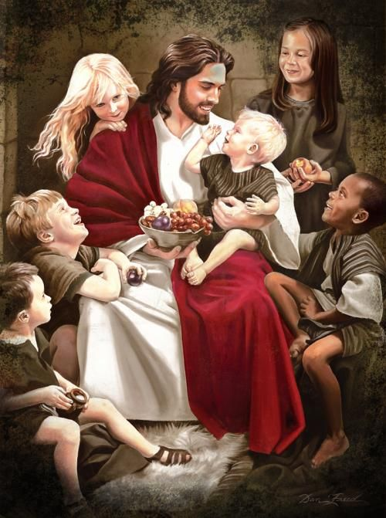
What the Bible says about Discipline
Whoever spares the rod hates their children, but the one who loves their children is careful to discipline them.
--Proverbs 13:24
The important word here is “love”

Slide 3
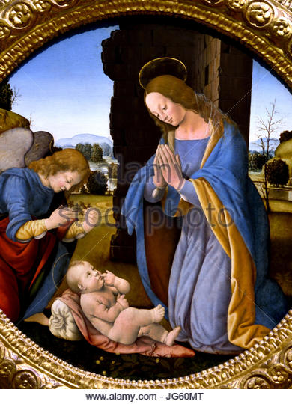
When Love isn’t the motivator
If discipline is motivated by anger or frustration then it can become abusive either physically or emotionally.
Fathers, do not exasperate your children; instead, bring them up in the training and instruction of the Lord.
- Ephesians 6:4

Slide 4
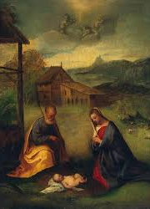
Why Children need Love and Discipline
Start children off on the way they should go, and even when they are old they will not turn from it.
- Proverbs 22:6

Slide 5
Hillsboro Christian academy policy
Page 41 of Handbook
Because of the increased incidences of child abuse in our nation, lawmakers have sought to write strict laws to protect children. For that reason all school, medical, and social service personnel are REQUIRED to report any suspected cases of child abuse either to the child protective agency or the local police.
Child abuse is NOT to be mistaken for spanking a child when he has misbehaved. However, repeated injuries including bruises, welts, psychological cruelty, sexual abuse etc. are considered abuses. The school is required by law to report all suspected cases of child abuse.

Slide 6
What to do if you suspect something is not right with one of your students.
Look for trends – dirty clothing, bruising, scratches, not eating, frequent injuries/falls, clothing not appropriate for weather – long sleeves in the summer, flinching at loud noises or touch
Share your concerns with the Principal – verbally discuss, provide in writing any specific injuries/bruising (may use incident report)
The Principal will then further investigate the issue or determine if immediate reporting to authorities should be made.
Do not discuss the issue/concern with other students and staff

Slide 7
Please watch and complete the Questions with this link
https://www.virtuallabschool.org/preschool/safe-environments/lesson-7

Slide 8
A new command I give you : Love one another. As I have loved you, so you must love one another. By this is everyone will know that you are my disciples, if you love one another.
- John 13: 34-35

